Slide 1

Acknowledgement: these slides are partially based on Machine Learning for Cities course material from Dr. Stanislav Sobolevsky, used with permission.
Machine Learning for Cities
CUSP-GX 5003.001, Spring 2022
Lecture 5: Bayesian Methods for Supervised, Semi-Supervised, and Unsupervised Learning

Slide 2
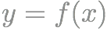
From Lecture 1…
ML problem paradigms represent a functional grouping of methods by what we’re trying to accomplish. A related grouping is based on what the data looks like, and in particular, whether we have labeled or unlabeled data.
Supervised Learning
Semi-supervised learning:
Only some data points are labeled; the goal is still typically prediction.
Data/input
Labels/output
Learn dependence:
Unsupervised learning:
No labels, just input data x_{i}. Various goals including clustering.
Discrete y = classification

Slide 3
From Lecture 1…
ML problem paradigms represent a functional grouping of methods by what we’re trying to accomplish. A related grouping is based on what the data looks like, and in particular, whether we have labeled or unlabeled data.
In today’s lecture we will learn about a class of methods, based on Bayesian probability, that cover the entire range from supervised to semi-supervised to unsupervised learning, including both classification and clustering.
Classification only (not regression).
Labeled and/or unlabeled data.
Can obtain class/cluster probabilities.
Supervised Learning
Semi-supervised learning:
Only some data points are labeled; the goal is still typically prediction.
Data/input
Labels/output
Learn dependence:
Unsupervised learning:
No labels, just input data x_{i}. Various goals including clustering.
Discrete y = classification

Slide 4
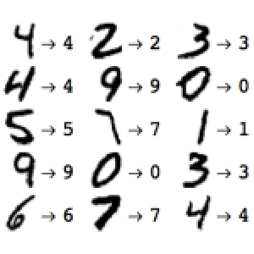
Model-based classification
Let’s start with the supervised case, where we have labeled training data.
We focus on classification, and ask, “How likely is this data point to be in each class?”
This question is important, e.g. for risk prediction, but hard to answer accurately using the methods that we’ve seen so far.
Solution: learn a probabilistic model for each class, then compute the class posterior probabilities using Bayes’ Theorem.

Slide 5
Using Bayes’ Theorem
Posterior probability that data record x_{i} belongs to class C_{j}:
Simple example: {has stripes, seen on land}
Likelihood of record x_{i}’s attribute values if it belongs to class C_{j}
Prior probability of class C_{j}
Normalize probabilities (must sum to 1)
Class
Prior
Likelihood
Unnormalized posterior
Horse
Zebra
Fish
Pr(Horse) = 0.4
Pr(Zebra) = 0.1
Pr(Fish) = 0.5
Pr(stripes, land | Horse) = 0.050
Pr(stripes, land | Zebra) = 0.950
Pr(stripes, land | Fish) = 0.002
0.4 x 0.050 = 0.020
0.1 x 0.950 = 0.095
0.5 x 0.002 = 0.001
0.116

Slide 6
Using Bayes’ Theorem
Posterior probability that data record x_{i} belongs to class C_{j}:
Simple example: {has stripes, seen on land}
Likelihood of record x_{i}’s attribute values if it belongs to class C_{j}
Prior probability of class C_{j}
Normalize probabilities (must sum to 1)
Class
Prior
Likelihood
Normalized posterior
Horse
Zebra
Fish
Pr(Horse) = 0.4
Pr(Zebra) = 0.1
Pr(Fish) = 0.5
Pr(stripes, land | Horse) = 0.050
Pr(stripes, land | Zebra) = 0.950
Pr(stripes, land | Fish) = 0.002
0.020 / 0.116 = 0.172
0.095 / 0.116 = 0.819
0.001 / 0.116 = 0.009

Slide 7
Using Bayes’ Theorem
Posterior probability that data record x_{i} belongs to class C_{j}:
Likelihood of record x_{i}’s attribute values if it belongs to class C_{j}
Prior probability of class C_{j}
Normalize probabilities (must sum to 1)
So how can we obtain the priors and likelihoods?
1. Prior knowledge (ask a domain expert).
200 horses, 50 zebras, 250 fish
2. Learn the priors and likelihoods from a representative “training” dataset.
Pr(horse) = 200 / 500 = 0.4
Pr(zebra) = 50 / 500 = 0.1
Pr(fish) = 250 / 500 = 0.5

Slide 8
Using Bayes’ Theorem
Posterior probability that data record x_{i} belongs to class C_{j}:
Likelihood of record x_{i}’s attribute values if it belongs to class C_{j}
Prior probability of class C_{j}
Normalize probabilities (must sum to 1)
So how can we obtain the priors and likelihoods?
1. Prior knowledge (ask a domain expert).
Dataset of N records
2. Learn the priors and likelihoods from a representative “training” dataset.
(“Maximum likelihood estimation”)

Slide 9
Using Bayes’ Theorem
Posterior probability that data record x_{i} belongs to class C_{j}:
Likelihood of record x_{i}’s attribute values if it belongs to class C_{j}
Prior probability of class C_{j}
Normalize probabilities (must sum to 1)
So how can we obtain the priors and likelihoods?
To learn the likelihoods Pr(x_{i} | C_{k}), we need a model of how the data is generated, for each class C_{k}.
In this lecture, we will consider one very simple (but very useful) way of building these models.
“naïve Bayes”

Slide 10
Model-based classification
Dataset representation: records x_{i}, attributes A_{j}, values v_{ij}
Gender | BMI | Diabetes? | Heart attack risk
Male | 26 | Yes | ???
To decide whether the patient’s risk is high or low, we must first compute the likelihood of seeing his attribute values for both high-risk and low-risk groups:
Pr(Gender = Male, BMI = 26, Diabetes = Yes | Risk = High)
Pr(Gender = Male, BMI = 26, Diabetes = Yes | Risk = Low)
Pr(Gender, BMI, Diabetes | Risk) = Pr(Gender | Risk) Pr(BMI | Risk) Pr(Diabetes | Risk)
Naïve Bayes assumption: All attribute values are conditionally independent given the class.

Slide 11
Model-based classification
Dataset representation: records x_{i}, attributes A_{j}, values v_{ij}
Gender | BMI | Diabetes? | Heart attack risk
Male | 26 | Yes | ???
To decide whether the patient’s risk is high or low, we must first compute the likelihood of seeing his attribute values for both high-risk and low-risk groups:
Pr(Gender = Male, BMI = 26, Diabetes = Yes | Risk = High)
Pr(Gender = Male, BMI = 26, Diabetes = Yes | Risk = Low)
Pr(Gender, BMI, Diabetes | Risk) = Pr(Gender | Risk) Pr(BMI | Risk) Pr(Diabetes | Risk)
Pr(A_{j} = v_{ij} | C = C_{k})
Pr(x_{i} | C = C_{k})
Class
Gender = Male
BMI = 26
Diabetes = Yes
Total likelihood
Risk = Low
0.44
0.01
0.03
1.32 x 10⁻⁴
Risk = High
0.53
0.02
0.45
4.77 x 10⁻³
Pr(Gender = Male | Risk = High) = 0.53

Slide 12
Model-based classification
Dataset representation: records x_{i}, attributes A_{j}, values v_{ij}
Gender | BMI | Diabetes? | Heart attack risk
Male | 26 | Yes | ???
To decide whether the patient’s risk is high or low, we must first compute the likelihood of seeing his attribute values for both high-risk and low-risk groups:
Pr(Gender = Male, BMI = 26, Diabetes = Yes | Risk = High)
Pr(Gender = Male, BMI = 26, Diabetes = Yes | Risk = Low)
Pr(Gender, BMI, Diabetes | Risk) = Pr(Gender | Risk) Pr(BMI | Risk) Pr(Diabetes | Risk)
Now we can use Bayes’ Theorem:
Unnormalized posterior
Class
Total likelihood
Prior
Posterior
Risk = Low
1.32 x 10⁻⁴
0.9
1.19 x 10⁻⁴
1.19 / 5.96 = 0.2
Risk = High
4.77 x 10⁻³
0.1
4.77 x 10⁻⁴
4.77 / 5.96 = 0.8
5.96 x 10⁻⁴

Slide 13
Model-based classification
Dataset representation: records x_{i}, attributes A_{j}, values v_{ij}
Gender | BMI | Diabetes? | Heart attack risk
Male | 26 | Yes | ???
To decide whether the patient’s risk is high or low, we must first compute the likelihood of seeing his attribute values for both high-risk and low-risk groups:
Pr(Gender = Male, BMI = 26, Diabetes = Yes | Risk = High)
Pr(Gender = Male, BMI = 26, Diabetes = Yes | Risk = Low)
Pr(Gender, BMI, Diabetes | Risk) = Pr(Gender | Risk) Pr(BMI | Risk) Pr(Diabetes | Risk)
Question 1: How to estimate the conditional probability of a discrete attribute?
For example, if there were 500 training records with Risk = High, and 265 of these also had Gender = Male, our probability estimate would be 265 / 500 = 0.53.

Slide 14
Model-based classification
Dataset representation: records x_{i}, attributes A_{j}, values v_{ij}
Gender | BMI | Diabetes? | Heart attack risk
Male | 26 | Yes | ???
To decide whether the patient’s risk is high or low, we must first compute the likelihood of seeing his attribute values for both high-risk and low-risk groups:
Pr(Gender = Male, BMI = 26, Diabetes = Yes | Risk = High)
Pr(Gender = Male, BMI = 26, Diabetes = Yes | Risk = Low)
Pr(Gender, BMI, Diabetes | Risk) = Pr(Gender | Risk) Pr(BMI | Risk) Pr(Diabetes | Risk)
Question 2: How to estimate the conditional probability* of a real-valued attribute?
Solution: learn a Gaussian distribution from all of the training records with Risk = High, and use this distribution to estimate the probability.
This is called Gaussian Naïve Bayes classification.
*Technically, we are estimating the probability density f(x), not the probability of drawing x.

Slide 15
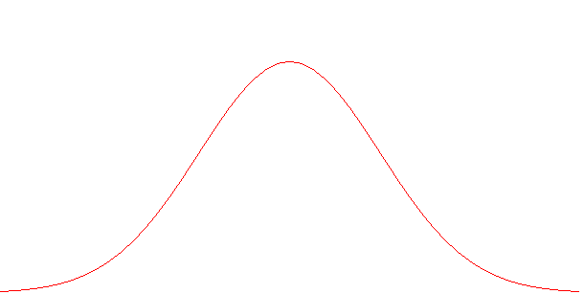
Review of the Gaussian distribution
Also called “normal distribution” or “bell curve”.
A good approximation for many real-world distributions.
Central Limit Theorem: The sum (or mean) of sufficiently many i.i.d. samples from any distribution is approximately Gaussian.
A symmetric, unimodal distribution N(μ, σ), determined by its mean μ and standard deviation σ:
μ determines the center of the distribution, and σ determines its spread.
Given μ and σ, we can compute the probability density f(x) for any x.
σ
σ
μ-3σ
μ-2σ
μ-1σ
μ
μ+1σ
μ+2σ
μ+3σ

Slide 16
Review of the Gaussian distribution
Also called “normal distribution” or “bell curve”.
A good approximation for many real-world distributions.
Central Limit Theorem: The sum (or mean) of sufficiently many i.i.d. samples from any distribution is approximately Gaussian.
A symmetric, unimodal distribution N(μ, σ), determined by its mean μ and standard deviation σ:
μ determines the center of the distribution, and σ determines its spread.
Given μ and σ, we can compute the probability density f(x) for any x.
10
10
For example, if we have μ = 100 and σ = 10, then f(120) = .0054.
70
80
90
100
110
120
130

Slide 17
Learning Gaussian distributions
Gaussians are simple to learn from training data:
μ = sample mean of x_{i}
σ = sample standard deviation of x_{i}
For example, consider the distribution of body mass index (BMI) for patients with low and high heart attack risks respectively:
Low risk (4500 patients): mean = 20.0, standard deviation = 2.6
High risk (500 patients): mean = 32.0, standard deviation = 3.1
Probability density of BMI = 26 for Low risk group: f(x = 26 | N(20, 2.6)) = .01
Probability density of BMI = 26 for High risk group: f(x = 26 | N(32, 3.1)) = .02

Slide 18
Summary of Naïve Bayes
Step 1: Learn a class-conditional model for each attribute for each class, using the training data.
Discrete-valued attribute: Pr(A_{j} = v_{ij} | C = C_{k})
Real-valued attribute: μ and σ of A_{j} for C = C_{k}
Gender
BMI
Diabetes
Pr(Male) = 0.44
Pr(Female) = 0.56
μ = 20
σ = 2.6
Pr(Diabetes) = 0.03
Pr(No diabetes) = 0.97
Risk = Low
Risk = High
Pr(Male) = 0.53
Pr(Female) = 0.47
μ = 32
σ = 3.1
Pr(Diabetes) = 0.45
Pr(No diabetes) = 0.55
Step 2: To classify a given test record, first compute the likelihood of each of its attributes given each class, and multiply to obtain the total likelihood.
Gender = Male
BMI = 26
Diabetes = Yes
Total likelihood
Risk = Low
0.44
0.01
0.03
1.32 x 10⁻⁴
Risk = High
0.53
0.02
0.45
4.77 x 10⁻³

Slide 19
Summary of Naïve Bayes
Step 1: Learn a class-conditional model for each attribute for each class, using the training data.
Discrete-valued attribute: Pr(A_{j} = v_{ij} | C = C_{k})
Real-valued attribute: μ and σ of A_{j} for C = C_{k}
Gender
BMI
Diabetes
Pr(Male) = 0.44
Pr(Female) = 0.56
μ = 20
σ = 2.6
Pr(Diabetes) = 0.03
Pr(No diabetes) = 0.97
Risk = Low
Risk = High
Pr(Male) = 0.53
Pr(Female) = 0.47
μ = 32
σ = 3.1
Pr(Diabetes) = 0.45
Pr(No diabetes) = 0.55
Step 3: Then obtain the prior probability of each class from the training data, and combine this with the likelihood using Bayes’ Theorem.
Unnormalized posterior
Total likelihood
Prior
Posterior
Risk = Low
1.32 x 10⁻⁴
0.9
1.19 x 10⁻⁴
0.2
Risk = High
4.77 x 10⁻³
0.1
4.77 x 10⁻⁴
0.8

Slide 20
When to use Naïve Bayes
We have a dataset, with some class we want to predict.
We can only do classification, not regression!
Datasets with lots of attributes, and/or lots of records, are okay.
Datasets with discrete or real values, or both, are okay.
We can predict the posterior probability of each class, and use these probabilities to make decisions.
We want to create an interpretable model of each class, and understand how each attribute affects our predictions.
For a discrete attribute, which values are common for each class?
For a real attribute, what are μ and σ for each class?
For a given test record, compare the class-conditional likelihoods for each attribute.
Performance is better when the given model makes sense.
Naïve Bayes assumes all attributes are conditionally independent given the class. This assumption does well most of the time…
We can also use a more complicated model for each class, such as a Bayesian network (to be discussed in a future lecture).

Slide 21
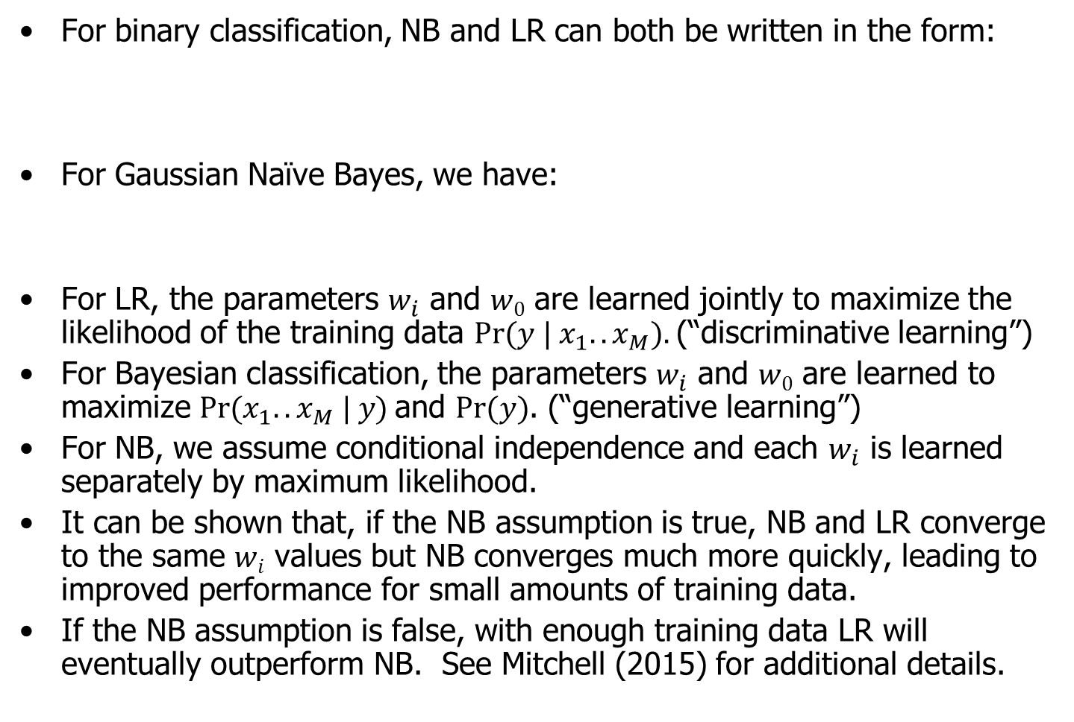
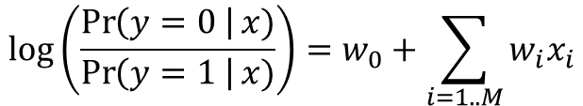
Naïve Bayes vs. Logistic Regression
For binary classification, NB and LR can both be written in the form:
For Gaussian Naïve Bayes, we have:
For LR, the parameters $w_{i}$ and $w0$ are learned jointly to maximize the likelihood of the training data $Pr⁡(y | x_{1}..x_{M}).$(“discriminative learning”)
For Bayesian classification, the parameters $w_{i}$ and $w0$ are learned to maximize $Pr⁡(x_{1}..x_{M} | y)$and $Pr⁡(y)$. (“generative learning”)
For NB, we assume conditional independence and each $w_{i}$ is learned separately by maximum likelihood.
It can be shown that, if the NB assumption is true, NB and LR converge to the same $wi$ values but NB converges much more quickly, leading to improved performance for small amounts of training data.
If the NB assumption is false, with enough training data LR will eventually outperform NB. See Mitchell (2015) for additional details.
$$\log\left(\frac{\operatorname{Pr}\left(y=0 \right|x)}{\operatorname{Pr}\left(y=1 \right|x)}\right)=w_{0}+\sum_{i=1..M}{w_{i}x_{i}}$$
This sum is over the attributes (columns), for a single data record.
See Mitchell (2015) for the derivation.

Slide 22
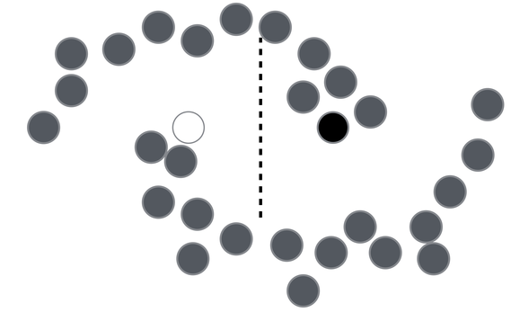
From supervised to semi-supervised…
If you have a small amount of labeled data and a large amount of unlabeled data (a very common situation in the real world…), the unlabeled data can often be used to improve prediction performance.
For unlabeled data to improve performance, we must assume some structure to the underlying data distribution. Typical assumption of smoothness: data points near each other tend to belong to same class.
For example, can dramatically improve the performance of Naïve Bayes text classification using EM.
?
Image credit: Rinu Boney, http://rinuboney.github.io/2016/01/19/ladder-network.html
K. Nigam, A. K. McCallum, S. Thrun, and T. Mitchell. Text classification from labeled and unlabeled documents using EM. Machine Learning, 39(2/3):103–134, 2000.

Slide 23
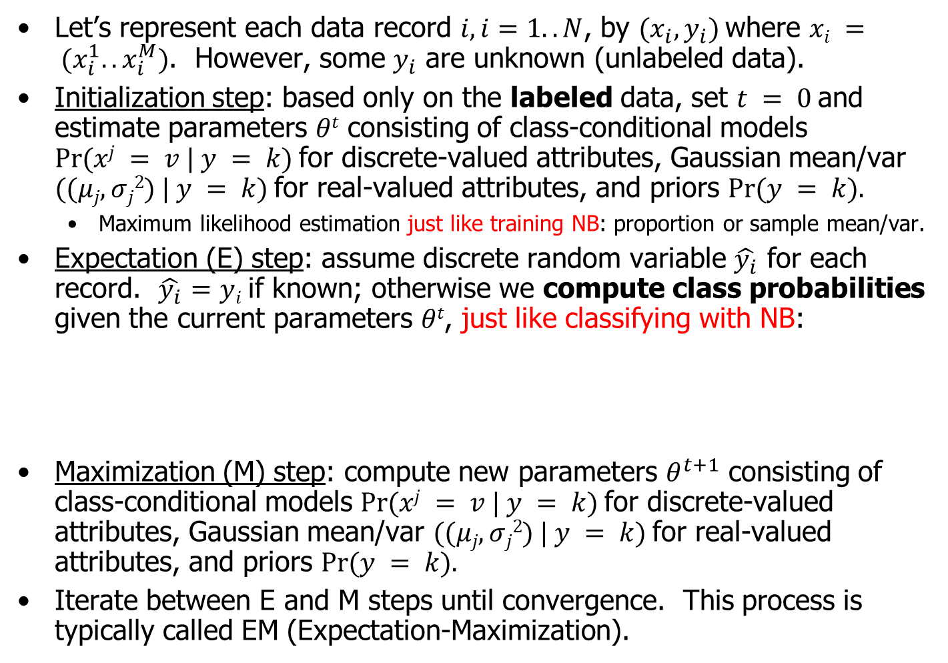
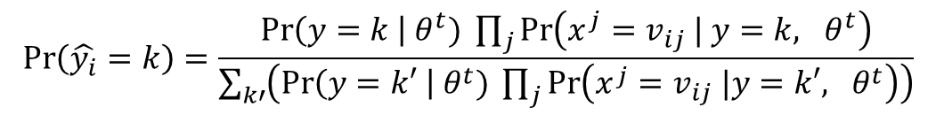
Semi-Supervised Naïve Bayes
Let’s represent each data record $i, i=1..N$, by $(x_{i}, y_{i})$where $xi = (x_{i}^{1}..x_{i}^{M})$. However, some $y_{i}$ are unknown (unlabeled data).
Initialization step: based only on the labeled data, set $t = 0$and estimate parameters $θt$ consisting of class-conditional models $Pr⁡(xj = v | y = k)$for discrete-valued attributes, Gaussian mean/var $((μj, σj2) | y = k)$for real-valued attributes, and priors $Pr⁡(y = k).$
Maximum likelihood estimation just like training NB: proportion or sample mean/var.
Expectation (E) step: assume discrete random variable $\hat{y_{i}}$ for each record. $\hat{y_{i}}$ $=yi$if known; otherwise we compute class probabilities given the current parameters $θt$, just like classifying with NB:
Maximization (M) step: compute new parameters $θ^{t+1}$ consisting of class-conditional models $Pr⁡(xj = v | y = k)$for discrete-valued attributes, Gaussian mean/var $((μj, σj2) | y = k)$for real-valued attributes, and priors $Pr⁡(y = k).$
Iterate between E and M steps until convergence. This process is typically called EM (Expectation-Maximization).
$$\operatorname{Pr}\left(\hat{y_{i}}=k\right)=\frac{\operatorname{Pr}\left(y=k \right| θ^{t}) \prod_{j}{\operatorname{Pr}\left(x^{j}=v_{ij} | y=k, θ^{t}\right)}}{\sum_{k′}{\left(\operatorname{Pr}\left(y=k′ \right| θ^{t}) \prod_{j}{\operatorname{Pr}\left(x^{j}=v_{ij} |y=k′, θ^{t}\right)}\right)}}$$

Slide 24
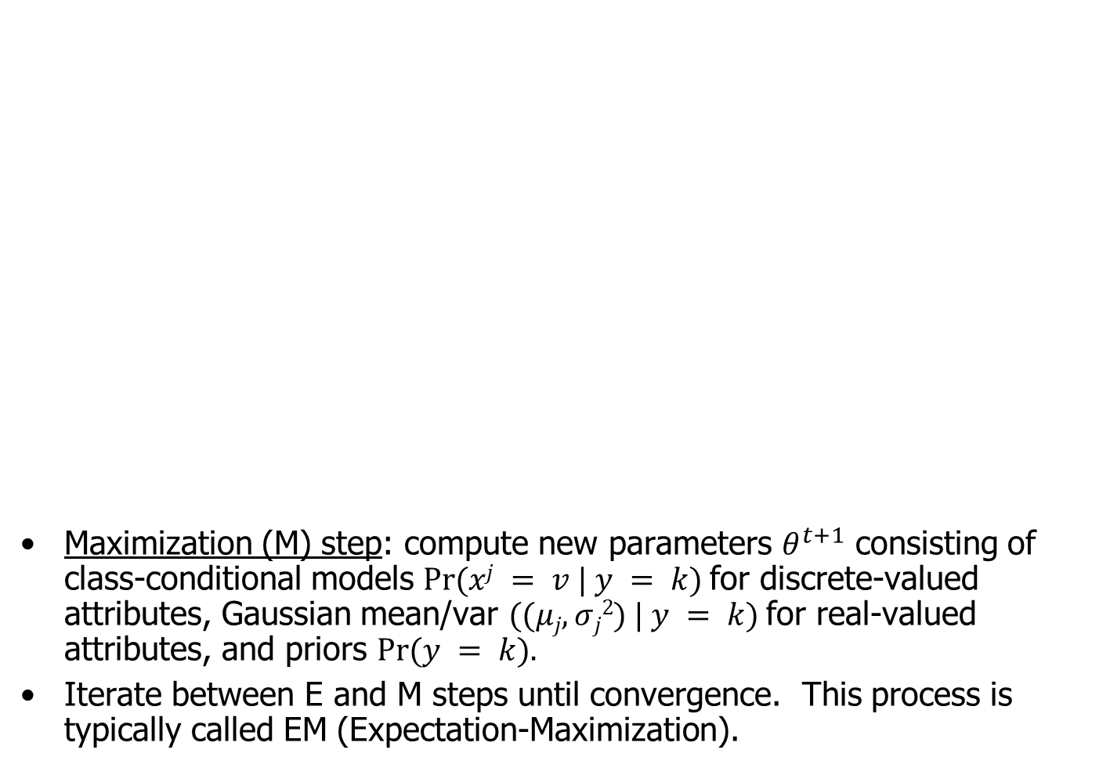
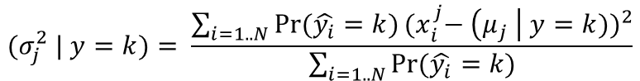
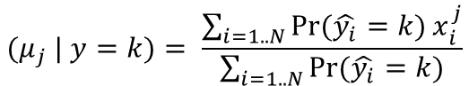
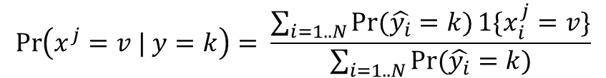
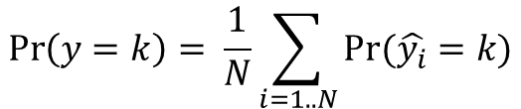
Semi-Supervised Naïve Bayes
Maximization (M) step: compute new parameters $θ^{t+1}$ consisting of class-conditional models $Pr⁡(xj = v | y = k)$for discrete-valued attributes, Gaussian mean/var $((μj, σj2) | y = k)$for real-valued attributes, and priors $Pr⁡(y = k).$
Iterate between E and M steps until convergence. This process is typically called EM (Expectation-Maximization).
The maximization step is just like training NB, except that each data record with unknown y_{i} is treated as a partial observation of each class, weighted proportionally to the estimated class probabilities.
$$\operatorname{Pr}\left(y=k\right)= \frac{1}{N}\sum_{i=1..N}{Pr⁡(\hat{y_{i}}=k)}$$
$$\operatorname{Pr}\left(x^{j}=v | y=k\right)= \frac{\sum_{i=1..N}{Pr⁡(\hat{y_{i}}=k)}1\{x_{i}^{j}=v\}}{\sum_{i=1..N}{Pr⁡(\hat{y_{i}}=k)}}$$
$${(μ}_{j} | y=k)= \frac{\sum_{i=1..N}{Pr⁡(\hat{y_{i}}=k)}x_{i}^{j}}{\sum_{i=1..N}{Pr⁡(\hat{y_{i}}=k)}}$$
$$(σ_{j}^{2} | y=k)= \frac{\sum_{i=1..N}{Pr⁡(\hat{y_{i}}=k)}{{(x}_{i}^{j}− \left(μ_{j} \right| y=k))}^{2}}{\sum_{i=1..N}{Pr⁡(\hat{y_{i}}=k)}}$$

Slide 25
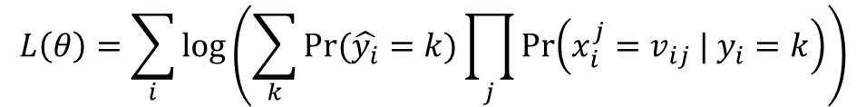
Semi-Supervised Naïve Bayes
The maximization step is just like training NB, except that each data record with unknown y_{i} is treated as a partial observation of each class, weighted proportionally to the estimated class probabilities.
$$\operatorname{Pr}\left(y=k\right)= \frac{1}{N}\sum_{i=1..N}{Pr⁡(\hat{y_{i}}=k)}$$
$$\operatorname{Pr}\left(x^{j}=v | y=k\right)= \frac{\sum_{i=1..N}{Pr⁡(\hat{y_{i}}=k)}1\{x_{i}^{j}=v\}}{\sum_{i=1..N}{Pr⁡(\hat{y_{i}}=k)}}$$
$${(μ}_{j} | y=k)= \frac{\sum_{i=1..N}{Pr⁡(\hat{y_{i}}=k)}x_{i}^{j}}{\sum_{i=1..N}{Pr⁡(\hat{y_{i}}=k)}}$$
$$(σ_{j}^{2} | y=k)= \frac{\sum_{i=1..N}{Pr⁡(\hat{y_{i}}=k)}{{(x}_{i}^{j}− \left(μ_{j} \right| y=k))}^{2}}{\sum_{i=1..N}{Pr⁡(\hat{y_{i}}=k)}}$$
The log-likelihood of the data increases monotonically on each step.
$$L\left(θ\right)=\sum_{i}{log\left(\sum_{k}{Pr⁡(\hat{y_{i}}=k)}\prod_{j}{Pr⁡\left(x_{i}^{j}=v_{ij} | y_{i}=k\right)}\right)}$$

Slide 26
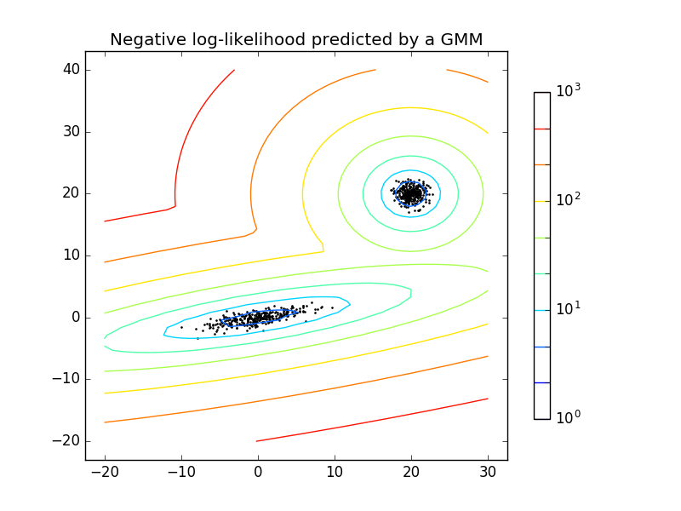
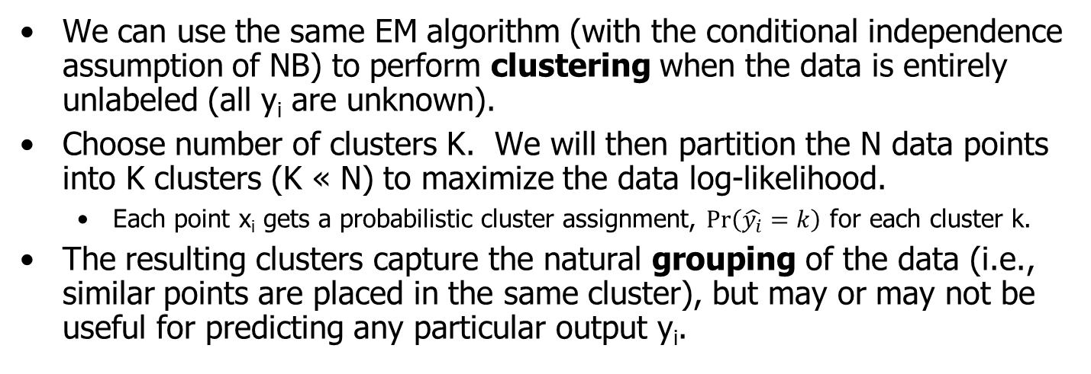
From semi-supervised to unsupervised…
We can use the same EM algorithm (with the conditional independence assumption of NB) to perform clustering when the data is entirely unlabeled (all y_{i} are unknown).
Choose number of clusters K. We will then partition the N data points into K clusters (K « N) to maximize the data log-likelihood.
Each point x_{i} gets a probabilistic cluster assignment, $\operatorname{Pr}\left(\hat{y_{i}}=k\right)$ for each cluster k.
The resulting clusters capture the natural grouping of the data (i.e., similar points are placed in the same cluster), but may or may not be useful for predicting any particular output y_{i}.

Slide 27
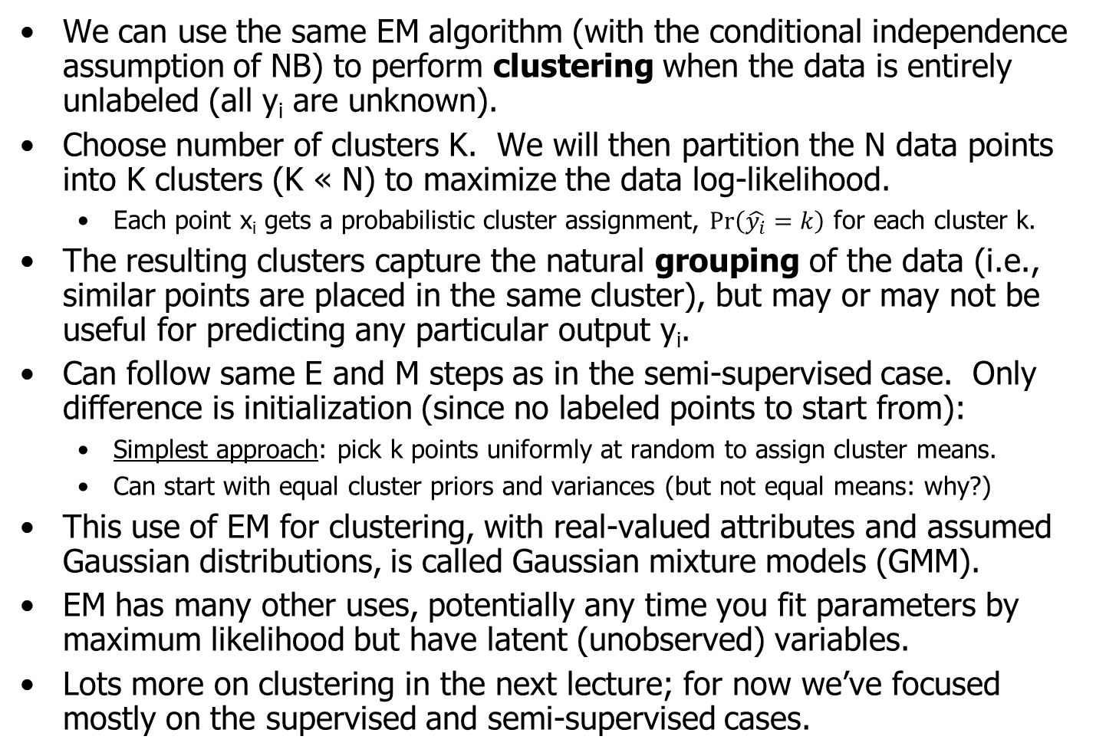
From semi-supervised to unsupervised…
We can use the same EM algorithm (with the conditional independence assumption of NB) to perform clustering when the data is entirely unlabeled (all y_{i} are unknown).
Choose number of clusters K. We will then partition the N data points into K clusters (K « N) to maximize the data log-likelihood.
Each point x_{i} gets a probabilistic cluster assignment, $\operatorname{Pr}\left(\hat{y_{i}}=k\right)$ for each cluster k.
The resulting clusters capture the natural grouping of the data (i.e., similar points are placed in the same cluster), but may or may not be useful for predicting any particular output y_{i}.
Can follow same E and M steps as in the semi-supervised case. Only difference is initialization (since no labeled points to start from):
Simplest approach: pick k points uniformly at random to assign cluster means.
Can start with equal cluster priors and variances (but not equal means: why?)
This use of EM for clustering, with real-valued attributes and assumed Gaussian distributions, is called Gaussian mixture models (GMM).
EM has many other uses, potentially any time you fit parameters by maximum likelihood but have latent (unobserved) variables.
Lots more on clustering in the next lecture; for now we’ve focused mostly on the supervised and semi-supervised cases.

Slide 28
References
Naïve Bayes:
Scikit-learn documentation for Naïve Bayes (supervised)
http://scikit-learn.org/stable/modules/naive_bayes.html
T.M. Mitchell (2015). Generative and discriminative classifiers: naïve Bayes and logistic regression. Ch. 3 of upcoming book, Machine Learning, 2nd ed. http://www.cs.cmu.edu/~tom/mlbook/NBayesLogReg.pdf
A.W. Moore. Probability for data miners, available at: https://www.cs.cmu.edu/~./awm/tutorials/prob.html
Duda, Hart, and Stork, Ch. 2, 3, and 10.
Expectation-Maximization (EM):
Scikit-learn documentation for Expectation Maximization (unsupervised- Gaussian mixture model)
http://scikit-learn.org/stable/modules/mixture.html
A.P. Dempster, N.M. Laird, and D.B. Rubin (1977). Maximum Likelihood from Incomplete Data via the EM Algorithm. Journal of the Royal Statistical Society, Series B. 39(1): 1–38.
A.W. Moore. Clustering with Gaussian mixtures, available at: https://www.cs.cmu.edu/~./awm/tutorials/gmm.html
Up next: a short break, and then Python examples for naïve Bayes and EM.

